Slide 1


SUSTAINABLE OUTREACH AND UNIVERSAL LEADERSHIP (SOUL) LIMITED Empowering Humanity….
December, 2022

Slide 2





History
Growth
Strong leadership team
Established in 2021 in collaboration with KIIT with focus on the IT and ITES enablement, covering business solutions starting from infrastructure services to IT-enabled services covering Digital, Robotics, Analytics and IoT
200+ employees
$2.5m revenue in 1st year
Team with extensive industry experience from various consulting domains.
SUSTAINABLE OUTREACH AND UNIVERSAL LEADERSHIP (SOUL) LIMITED
Ground Floor, New Block, Campus 1, Near Allahabad Bank, KIIT Patia, Bhubaneshwar - 751024
www.soulunileaders.com
Email: soul@soulunileaders.com
Phone: +91 7077769334
Capability
Partnership
Access to talent pool
Collaborating with strategic partners to synergize, optimize and economize the offered solutions and to make those strategies more effective.
Our focus is on the IT and ITES enablement, covering business solutions starting from infrastructure services to IT-enabled services covering Digital, Robotics, Analytics and IoT
Easy access to experts in different domains

Slide 3

SERVICE OFFERINGS

Slide 4

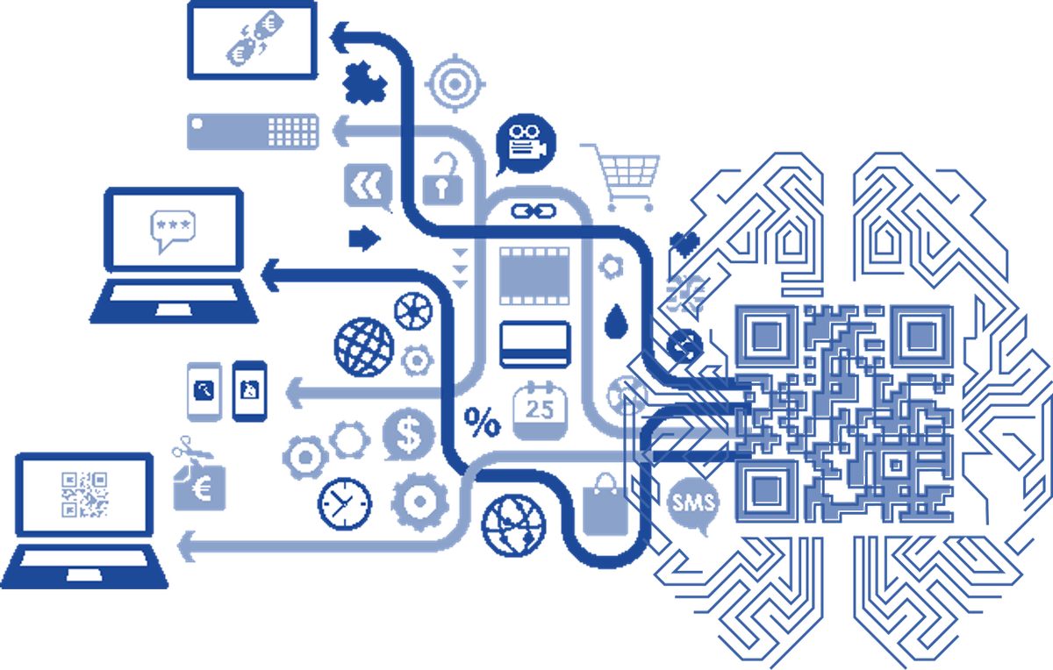




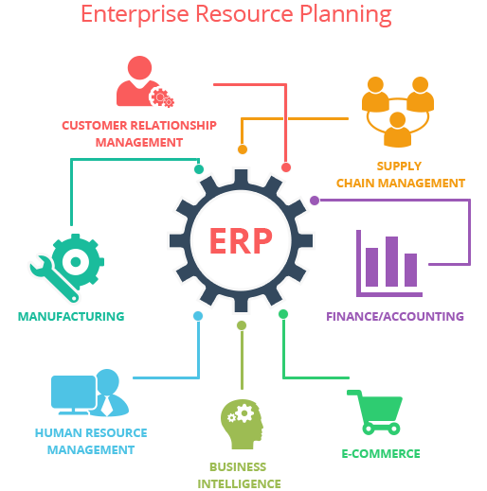
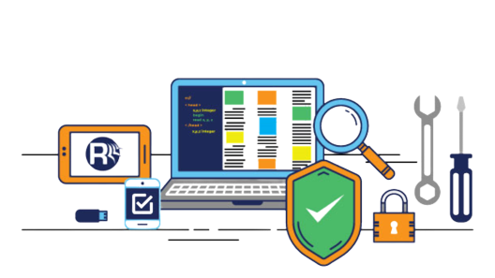
 | Application Development & Support |  | Data Analytics using AI-ML
Smart Infrastructure using IOT |  | Cloud Computing
 | Robotics |  | Consulting
ERP |  | Software Validation & Testing
Service Offering
Sustainable Outreach and Universal Leadership Limited
Ground Floor, New Block, Campus 1, Near Allahabad Bank, KIIT Patia, Bhubaneshwar – 751024

Slide 5
Application Development and Support
Design
Detailed Component Design.
Integration between various systems.
Identify appropriate framework.
Modularization of Components.
Implementation
Develop and Unit Test the system.
Ensuring the quality of the software.
Web Enabled Application (Internet/Intranet)
Architecture
Technology Assessment
Component Construction
Reusability of Components
Using latest architecture concepts
System Integration Testing
Test Planning
Functional Testing
Test Automation
Performance Testing
Code Coverage
Profiling
Legacy System Support and modernization
Business Process Management
Requirement Study
Requirement Definition describing the features to be implemented.
Defining Functional and non-functional requirements.
Acceptance definition for the projects
Middleware application
Deployment
System rollouts.
Product Documentation.
Installation Guides.
User Manual.
Data Migration.
Technology Transfer.
Enterprise Content Management
Project Planning and Initiation
Determining the right project methodology.
Waterfall/Agile/ Iterative model for implantation.
Detailed project plan with cost, schedule and resource estimates.
Resource identification and management plan.
Determining the engagement model and project governance approach.
Risk identification and mitigation plan.
System Administration and Database Support
Maintenance and Support
Mobile Apps

Slide 6
Data Analytics
Architecture
Data Management
Multi Cloud & Hybrid architecture
Data Modelling (Mesh / Fabric/ Vault)
Real Time Data Movement
Big Data Processing.
Data Pipeline & Integration.
Data Quality, MDM & Governance.
Data Lineage
Data Virtualization
Data Analytics
Dashboarding & Business Intelligence
Real time Visualization
Embedded Analytics in Reports
Adavanced Analytis Strategy & Roadmap
Machine Learning Augmentation
Cognitive. AI, chatbot & NLP
Data Visualization
Data Science

Slide 7
















CLOUD Capabilities
Tool Evaluation & Assessment
COSMOS
MariaDB
IOT Hub
Migration Services
COSMOS
MariaDB
IOT Hub
VM
Implementation & Deployment Services
Load Balancer
Storage Accounts
Load Balancer
Storage Accounts
Blueprint
Logic Apps
Blueprint
Maintenance & Support Services
Log Analytics
Power BI
VNet
AD
Monitor
VNet
ADF
Overview
Azure Readiness
Experience
A scalable architecture with use of PaaS Services such as IOT Edge, ELB & NoSQL databases
Dedicated CoE for Aazure
Implementation in ERP & IOT products
Resources with skills in multiple Azure Services
Design & development of applications
Integration with other cloud or on-premise application
Azure VM
Azure Database such as COSMOS, SQL Server & MariaDB
Azure IOT Hub
Azure Logic Apps
Azure Virtual Network

Slide 8
Digital Consulting & Implementation Services
Strategy
Implementation & Deployment
Managed services support
Project and Program Management
Data & information strategy & roadmap
Architecture services
Conceptualize IOT use cases
Data privacy , security and sovereignty
Cloud Architecture and Hybrid platform Strategy
Cloud migration and integration
Cloud Data warehousing & Big Data Engineering
IOT Edge & Analytics
Business Intelligence dashboards and reporting
Data architecture and enablement , platform design and implementation
Data science and machine learning augmentation
Cloud Maintenance & Monitoring
Analytics as a service
Data as a service
Platform maintenace & support
IOT device monitoring & support

Slide 9
Software Validation / Testing
Functional Testing
Functional Testing White Box Testing Black Box Testing Regression Testing Security Testing Authorization & Access Control Encryption and Decryption Middleware Testing Message Interface Testing Request Response Testing Script Record & Play Automated Functional Testing Navigational Testing User Interface Testing Load / Stress Testing Performance Testing Scalability Testing Vital Parameters (CPU Usage, Memory Leak) User Acceptance Testing Assistance Domain Testing Assistance to Business Users End User Simulation
Regression Testing
Usability
Testing
SPECIALIZED TESTING SERVICES
Test Strategy and planning
System and Integration Testing
Middleware
Testing
Load /
Stress
Testing
Test Consulting
CORE TESTING CAPABILITIES
Mobility
Testing
Security
Testing
UAT Support
Analytics
Testing
Data
Migration
Testing
Performance Testing
Automation Testing
Localization
Testing
Portability
Testing
Compatibility
Testing

Slide 10
IOT Based Smart Campus Solution
Build sustainable technology solutions to derive values and improve experience of users and the organization. Our solutions include smart environment monitoring, Parking Management & Surveilance, Asset tracking & monitoring, Energy Management
Smart Campus
Facilitate industries to transform themseleves by connecting devices / equipments, processes & people to improve process efficiency and monitor product quality
Industrial IoT
Provide innovative solutions by efficient analysis of data collected from IoT devices and generate useful insights.
Product IoT

Slide 11








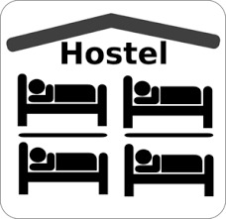





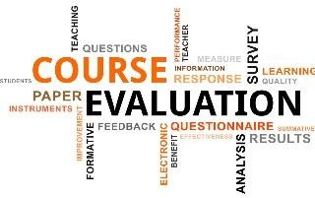

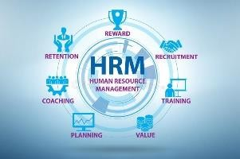
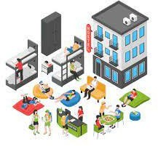

ERP - EDULEAD
Administration
Admission
Academics
Student Management
Attendance
Admit Card
Exam Management
Fee Management
Hostel Management
Time Table Management
Accounting & Payroll
Bio-metric Integration
SMS & E-mail Notifications
Student Exchange Program
Assessment Management
Report Card Generation
Bulk Data Management
HR Management
Materials Management
© Copyright SOUL LIMITED

Slide 12









Robotics
Robots & robotics
Your Educational Companions
Teaching assistants in schools,
Can be assembled and programmed by students.
Your Analysts
Learn and understand data; analyse patterns and generate reports.
Your Companions
Understand your likes and dislikes; help you with your daily chores.
Your Entertainers
Can engage people asking various questions, can entertain kids with tricks and dances; conducts games on special occasions.
Your Health Care Assistants
Monitor heart rate, pulse; alert when patient is in distress.
Your front Desk Assistants
Help you in various spaces such as banks, shopping malls, airports; help desks; answering
and guiding you.
Your Hosts
Can be MC in seminars, shows, events; Inaugurate and conduct.
Your Visitor Managers
Recognise people when known and remember them when they visit again.
Your Surveillance Assistants
Help you monitor zones that need special attention and monitoring on a regular basis. Also, alert the concerned in case of any turbulence.
Many more in the making...
..

Slide 13
CLIENT LIST

Slide 14


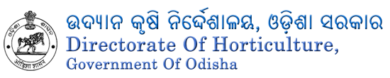









SOUL - Our Valued Clients
Client List

Slide 15
SELECTED CASE STUDIES

Slide 16
Selected Case Studies
PMU software for smart class implementation project
Custom ERP implementation in a university
STEP
20000+ students
Complete SLCM module development
Industry standard HR, Finance, Material Management modules
The web based module is hosted on cloud with high security using SSL and RBAC
Has integrations with Payment gateway and cloud based reporting tools.
More than 2000 class rooms
Web based application to conduct survey and collect data and provide inputs for workforce management
Ability to plan and monitor the project implementation
Various dashboard for different stakeholders
01
STEP
02
STEP
03

Slide 17
Selected Case Studies
Workflow based Invoice Tracking system for a medical institute
Analytics for equipment monitoring of smart class implementation in schools across the state
STEP
Web based Invoice Tracking solution for a leading hospital and medical institute
The web based module is hosted on cloud with high security using SSL and RBAC providing cloud based reporting tools.
Following business features are available as below:-
Workflow management :
File Management :
01
Mechanism to collect event log data using automated script
ETL Development using ADF to transform raw data to reportable data
Data Visualization using Power BI
Scalable solution to handle Billion+ records
STEP
02
STEP
03

Slide 18


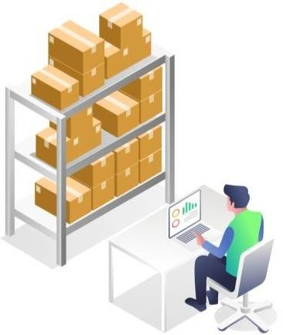
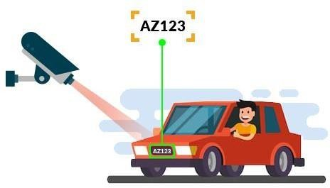
Selected Case Studies
Smart Environment Monitoring for large Campuses.
Smart Asset Management and
Tracking.
Smart Campus Security
SOUL Ltd. in collaboration with various Colleges & IT companies is working in designing and implementation of IoT’s’ in Educational Institutes.
An IoT ecosystem consists of Web-Enabled Smart Devices that use embedded processors, sensors and communication hardware to collect, send and act on data they acquire from their environments.
IoT devices share the sensor data they collect by connecting to an IoT gateway or other edge device where data is either sent to the cloud to be analyzed or analyzed locally.

Slide 19
TEAM

Slide 20
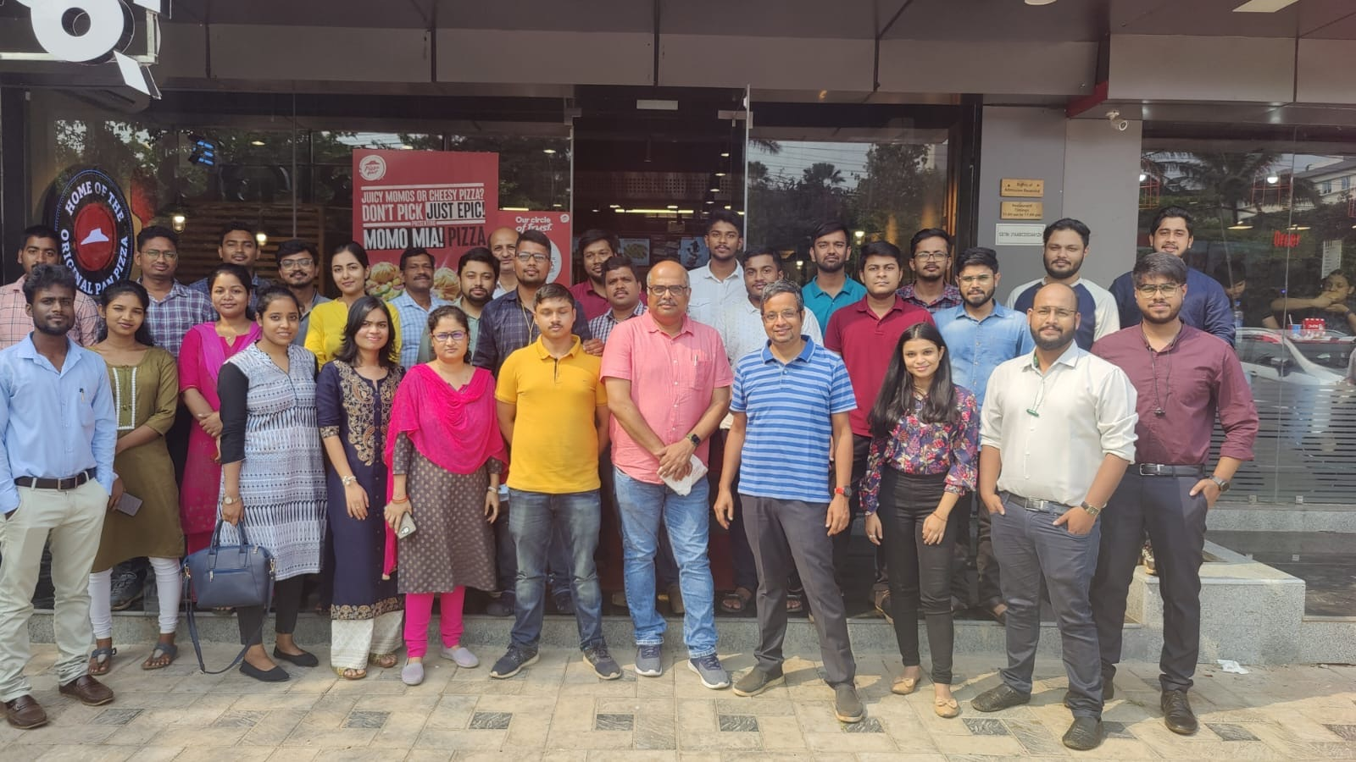
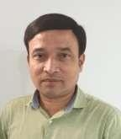
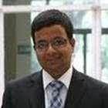
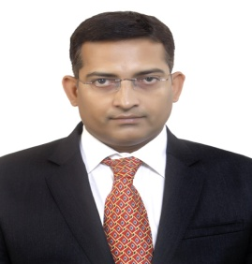
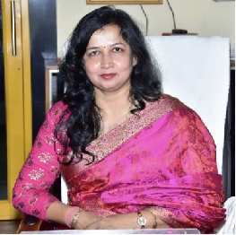
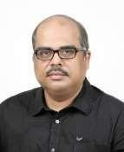
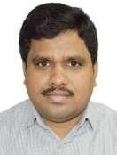
Team
SATYA NARAYANA MOHAPATRA
HIMANSU TRIPATHY
PARTHA SARATHI PATTANAYAK
20+ years as business consultant specializing in digital technologies, data management (integration,quality, MDM, governance and lineage)
25+ years of management consulting experience in India, Bangladesh, Nepal, Oman, Bahrain, Bhutan, Jamaica, Bangladesh, Lao PDR in the areas of – Corporate Governance, Organization Restructuring, HR strategy, manpower planning, Performance improvement and PMO
More than 25 years of overall IT and IAF Experience (Business Development, Project Management, in India &Abroad.
Dr. Sasmita Samanta
CHAIRPERSON
Vice Chancellor KIIT (Deemed to be University).
More than 25 years of experience in the Institution Building.
Leadership roles in diverse fields, taking up the roles of academician and administrator.
Strong experience in formulation of business strategy and implementation roadmaps for business transformation
DEBASISH MOHAPATRA
PABITRA BEHERA
25+ years of consulting experience in the power sectors of India, Nigeria, Tanzania, Thailand, Bangladesh, Nepal and SaudiArabia.
20+ years of overall solution delivery experience in IT industry

Slide 21
Thank You

